Slide 1
I/O Fundamentals
Team-System
RAJ KUMAR (1297722) KAVYASHREE (1199910) AMITH KUMAR T M (1192382)
KIRAN KALKURA M (1099205)
PRIYA DUBEY (1214676)

Slide 2
CONTENTS
Describing the basics of input and output
Read and write data from the console
Using streams (intro) to read and write files
Serialization intro
Read and write - serialization

Slide 3
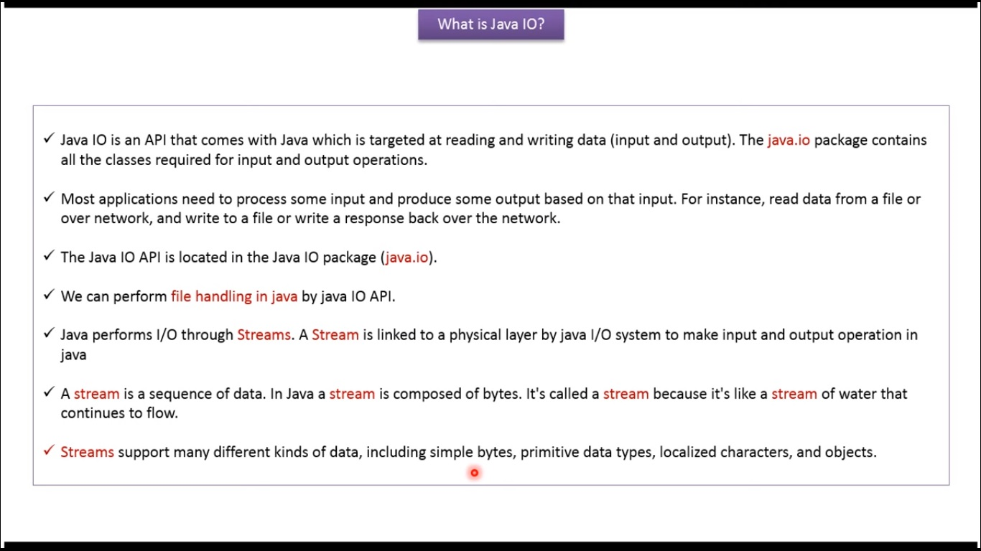
Describing the basics of input and output

Slide 4
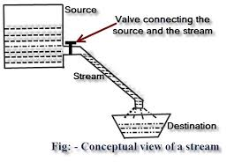
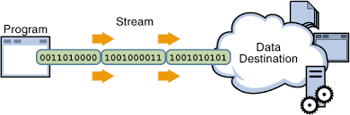

Slide 5
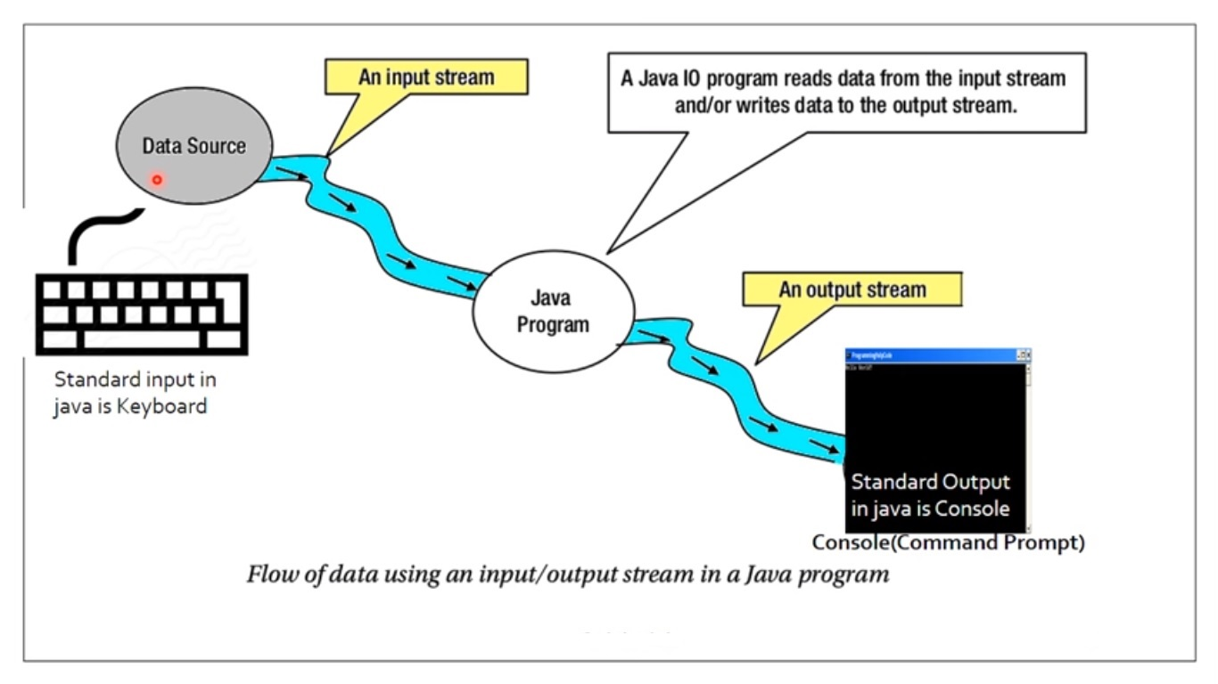

Slide 6
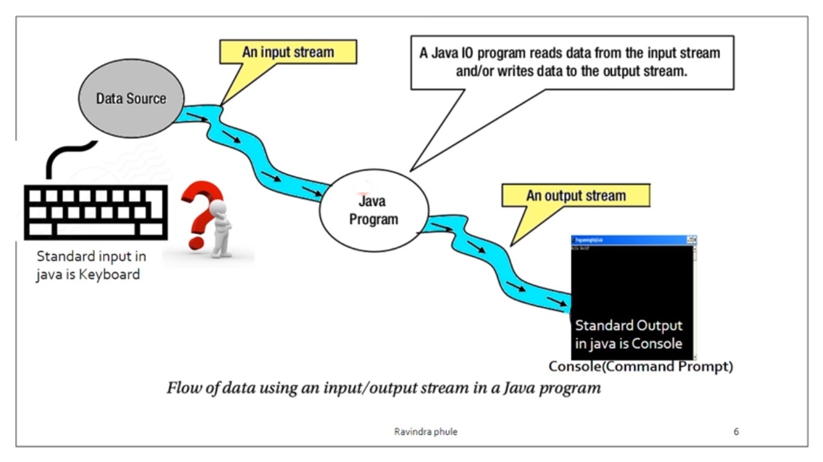

Slide 7
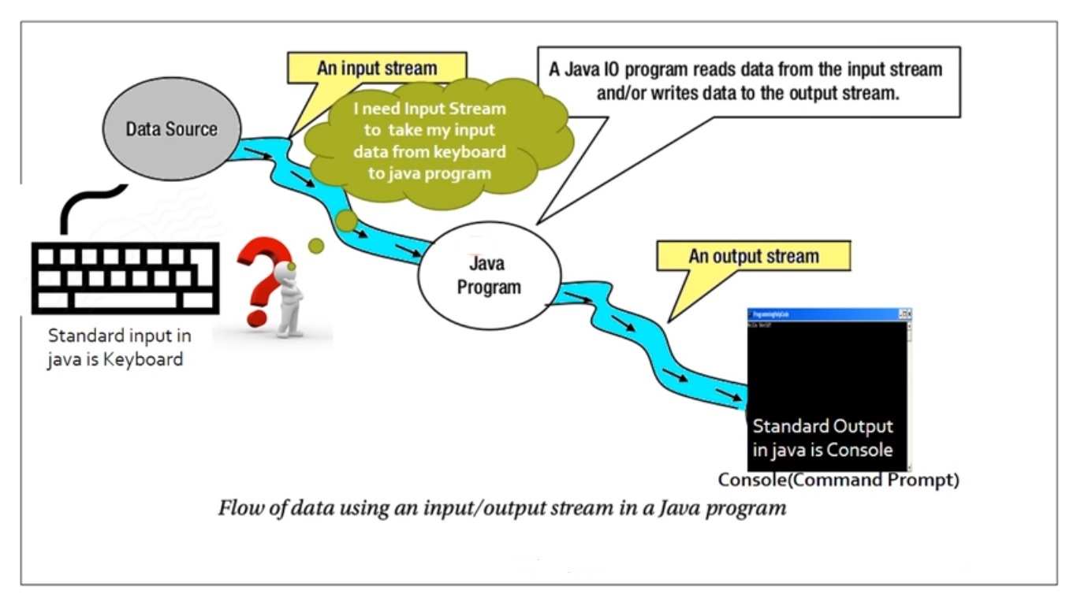

Slide 8
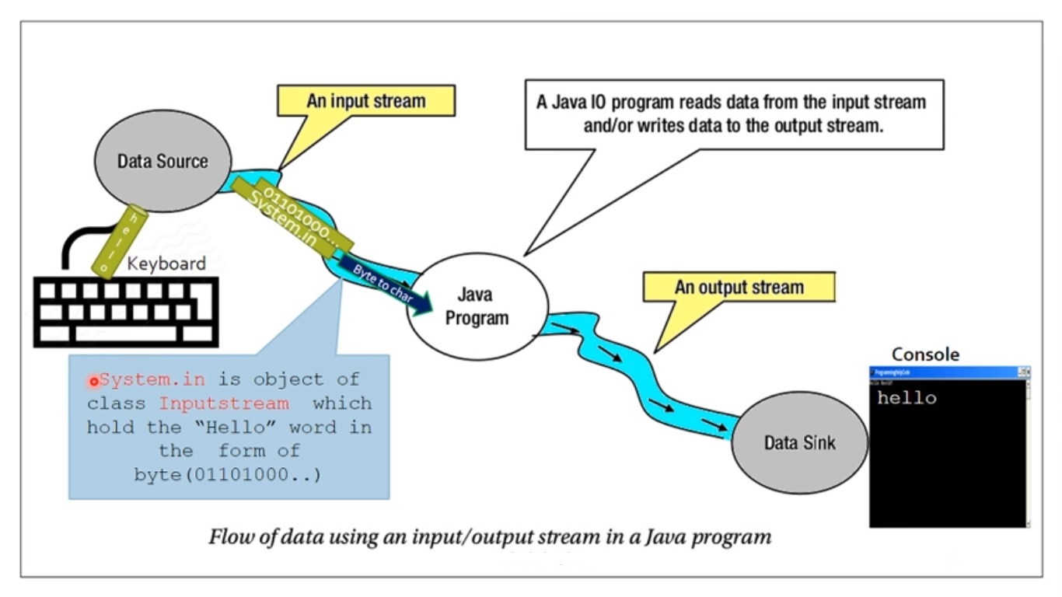

Slide 9
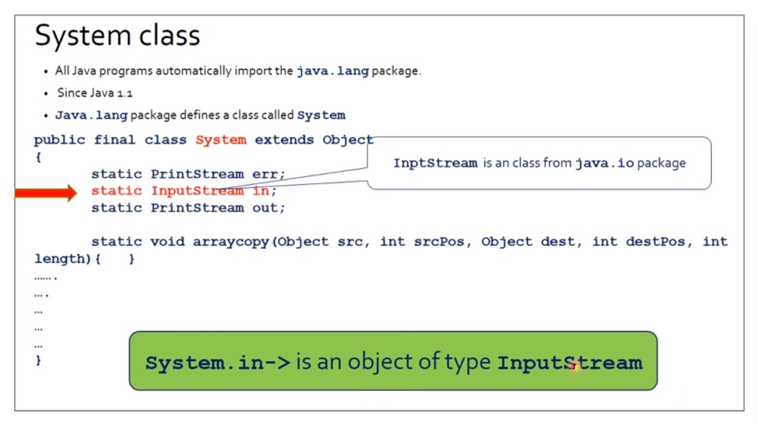

Slide 10
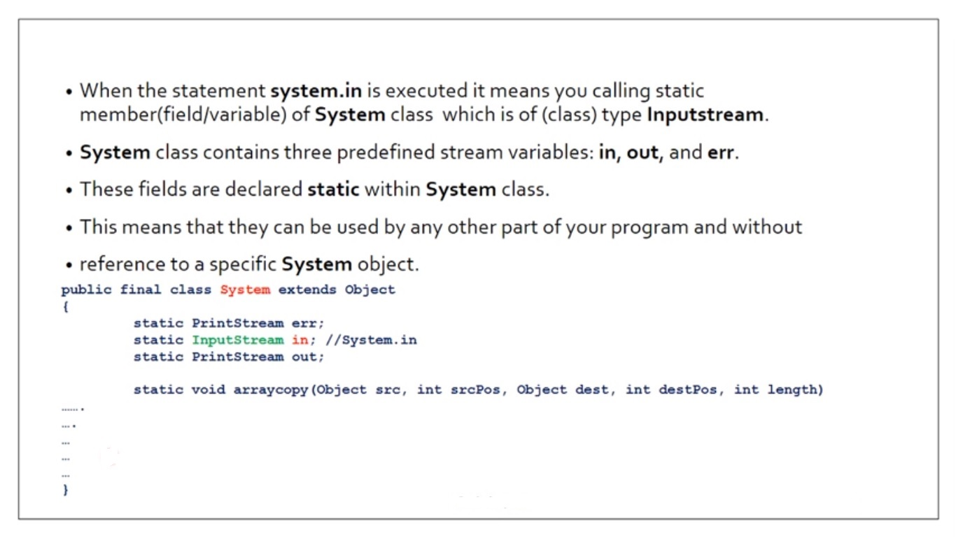

Slide 11
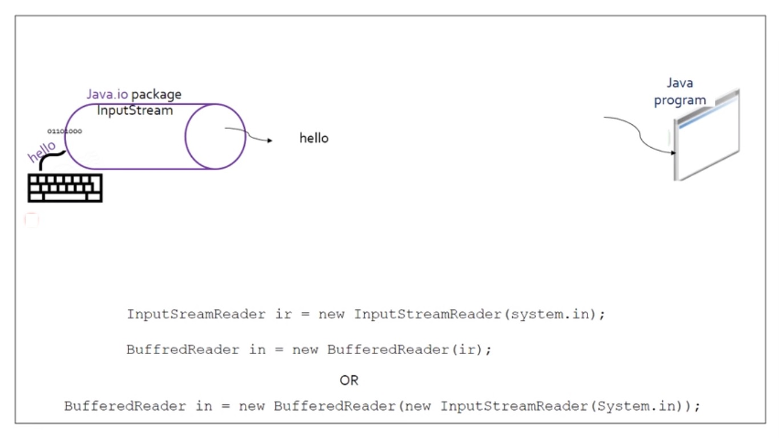

Slide 12
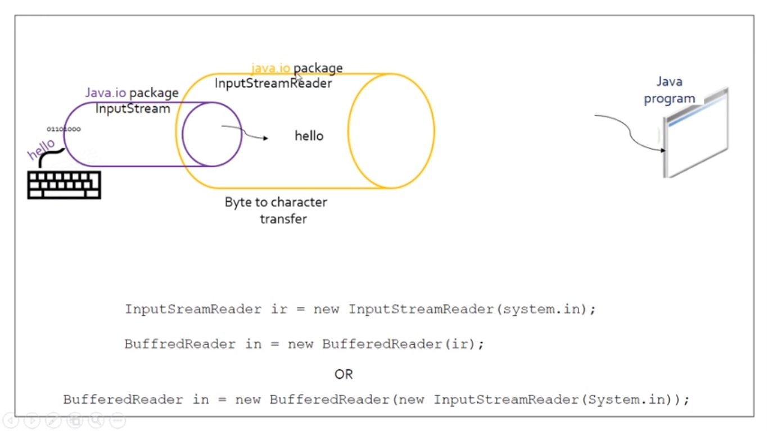

Slide 13
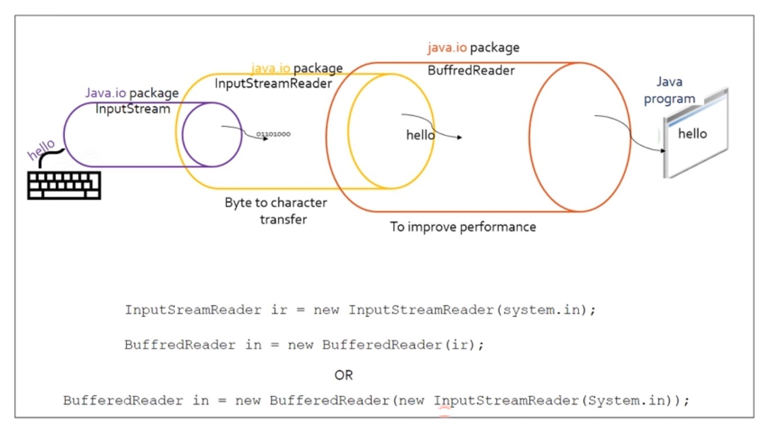

Slide 14
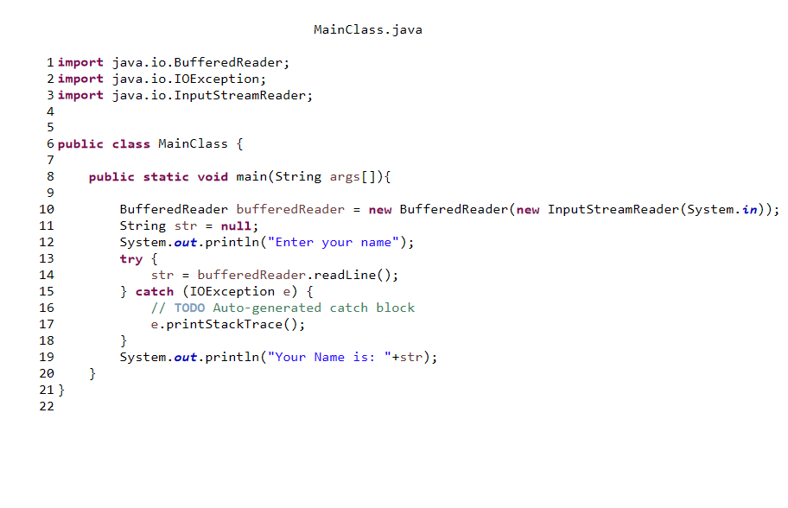
Enter your name
Raj
Your Name is: Raj

Slide 15
Stream
Java uses the concept of stream to make I/O operation fast.
A stream is a sequence of data
In java, 3 streams are created for us automatically. All these streams are attached with console.
1) System.out: standard output stream
2) System.in: standard input stream
3) System.err: standard error stream

Slide 16
The code to print output and error message to the console.
System.out.println("simple message");
System.err.println("error message");
The code to get input from console.
int i=System.in.read();//returns ASCII code of 1st character
System.out.println((char)i);

Slide 17
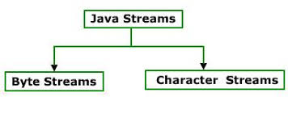
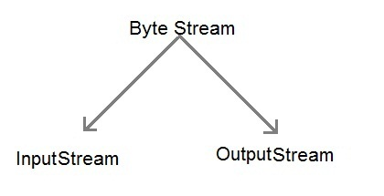
Types of streams
Byte Streams
Java byte streams are used to perform input and output of 8-bit bytes.
Byte oriented streams do not use any encoding scheme
The most frequently used classes are, FileInputStream and FileOutputStream.

Slide 18
Byte-Oriented Input Stream Classes
The following is the byte-oriented input stream class hierarchy:
InputStream
ByteArrayInputStream
FileInputStream
SequenceInputStream
ObjectInputStream
PipedInputStream
FilterInputStream
BufferedInputStream
DataInputStream
PushbackInputStream
ZipInputStream is defined in: java.util.zip
ZipInputStream

Slide 19
Byte-Oriented Output Stream Classes
The following is the byte-oriented input stream class hierarchy:
OutputStream
ByteArrayOutputStream
FileOutputStream
PipedOutputStream
ObjectOutputStream
FilterOutputStream
BufferedOutputStream
DataOutputStream
PrintStream
ZipOutputStream is defined in: java.util.zip
ZipOutputStream

Slide 20
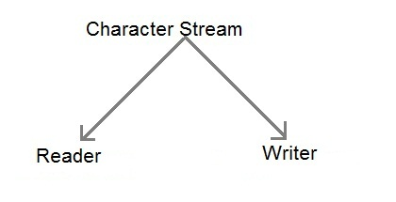
Character Streams
whereas Java Character streams are used to perform input and output for 16-bit unicode.
The most frequently used classes are FileReader and FileWriter.
FileReader uses FileInputStream and FileWriter uses FileOutputStream but here the major difference is that FileReader reads two bytes at a time and FileWriter writes two bytes at a time.

Slide 21
Character-Oriented Reader Classes
The following is the byte-oriented input stream class hierarchy:
Reader
PipedReader
CharArrayReader
StringReader
BufferedReader
FilterReader
InputStreamReader
LineNumberReader
PushbackReader
FileReader

Slide 22
Character-Oriented Writer Classes
The following is the byte-oriented input stream class hierarchy:
Writer
PipedWriter
CharArrayWriter
FileWriter
StringWriter
BufferedWriter
OutputStreamWriter
PrintWriter
FileWriter

Slide 23
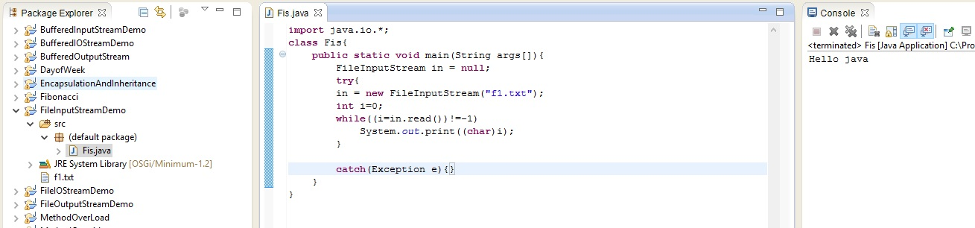
FILE INPUT STREAM

Slide 24
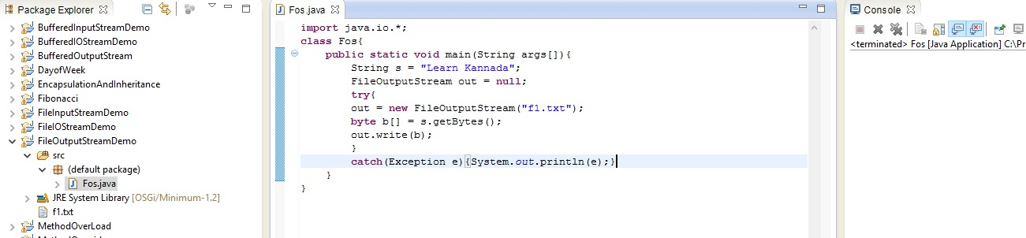
FILE OUTPUMT STREAM

Slide 25
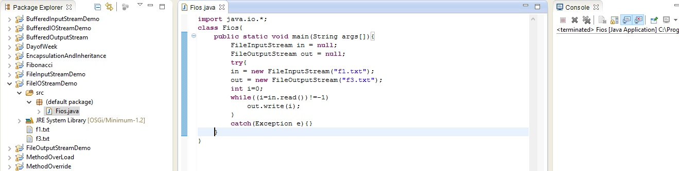
FILE INPUT AND FILE OUTPUT STREAM

Slide 26
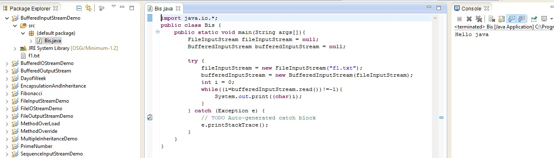
BUFFERED INPUT STREAM

Slide 27
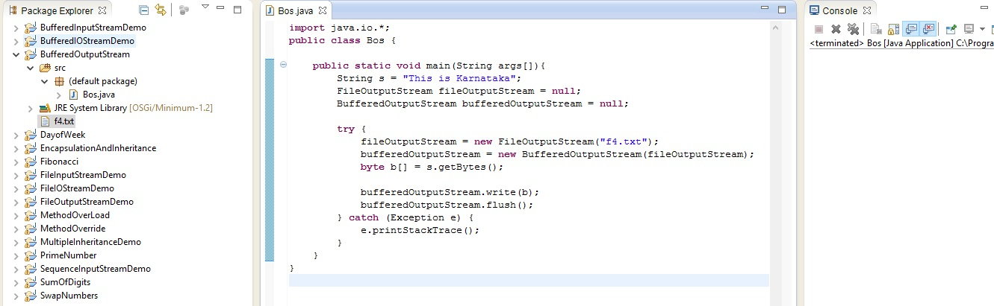
BUFFERED OUTPUT STREAM

Slide 28
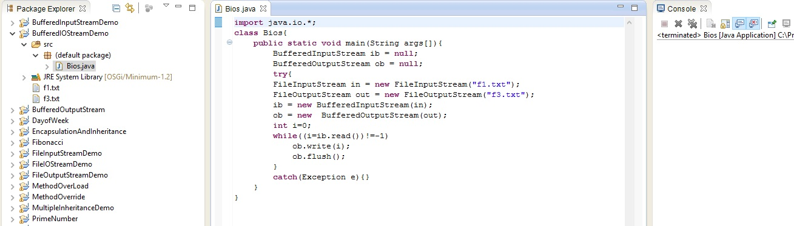
BUFFERED INPUT STREAM AND BUFFERED OUTPUT STREAM

Slide 29
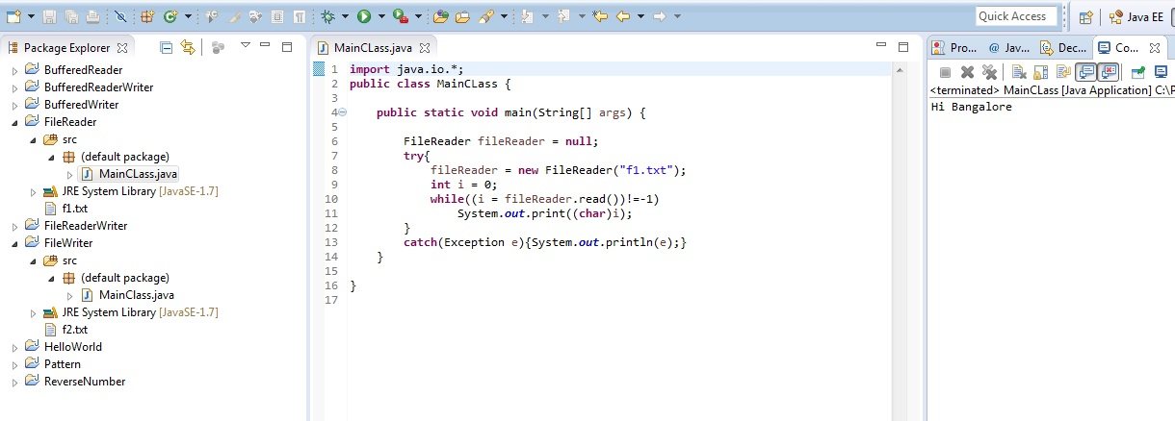
FILE READER

Slide 30
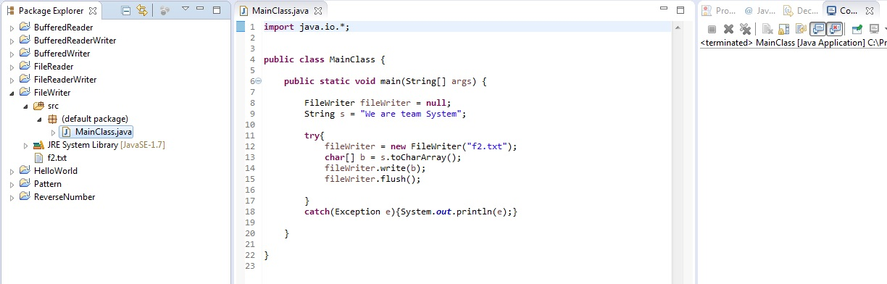
FILEWRITER

Slide 31
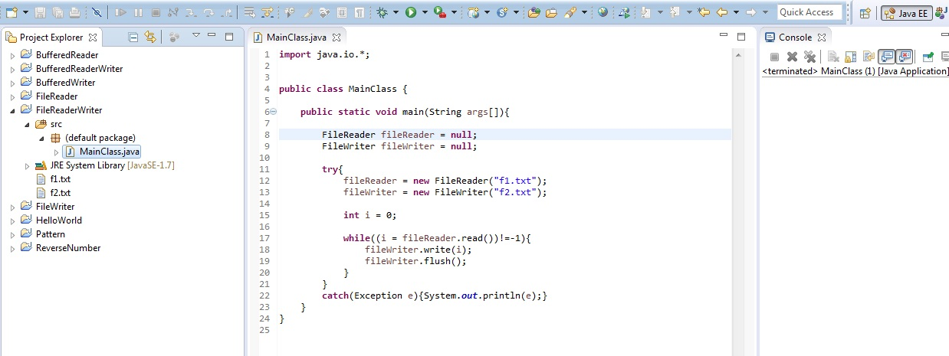
FILE READER AND FILE WRITER

Slide 32
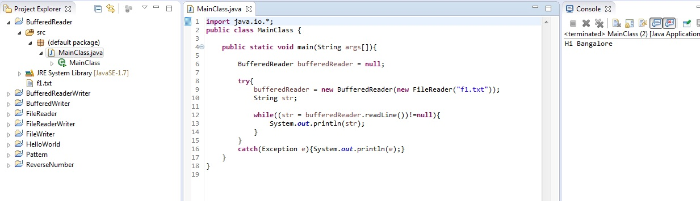
BUFFERED READER

Slide 33
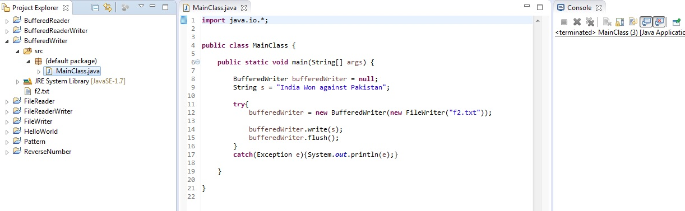
BUFFERED WRITER

Slide 34
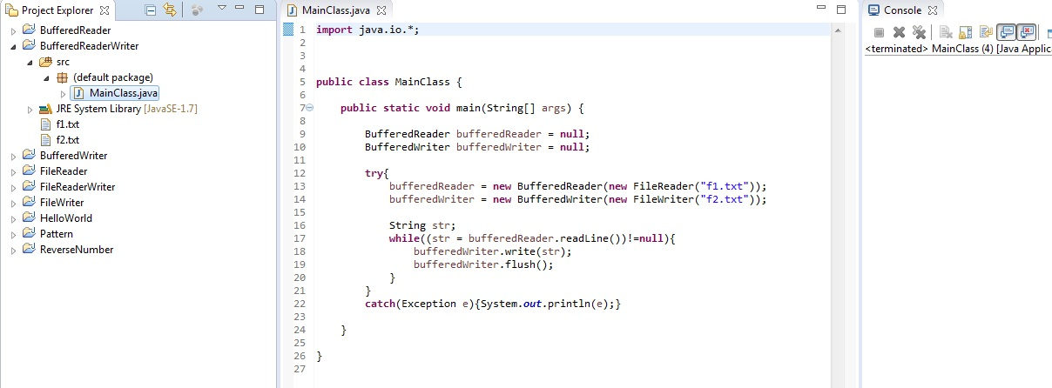
BUFFERED READER AND BUFFERED WRITER

Slide 35
SERIALIZATION

Slide 36
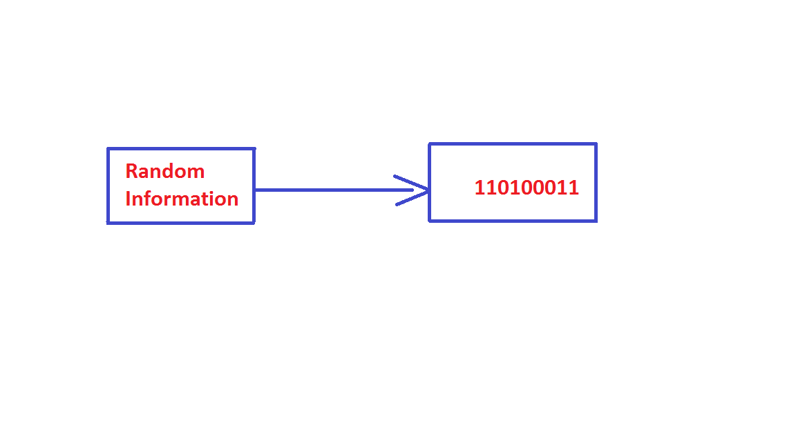
What is Serialization?
Mechanism of converting an object into stream of bytes.

Slide 37
Why use Serialization?
Send an object or piece of data through a network.
Save data into a file/disk.

Slide 38
Implementing Serialization
Implemented using java.io.Serializable interface
import java.io.Serializable;
public class Student implements Serializable
{
int id;
String name;
public Student(int id, String name)
{
this.id = id;
  this.name = name;
} }

Slide 39
ObjectOutputStream class
The ObjectOutputStream class is used to write primitive data types and Java objects to an OutputStream.
public ObjectOutputStream(OutputStream out) throws IOException {}

Slide 40
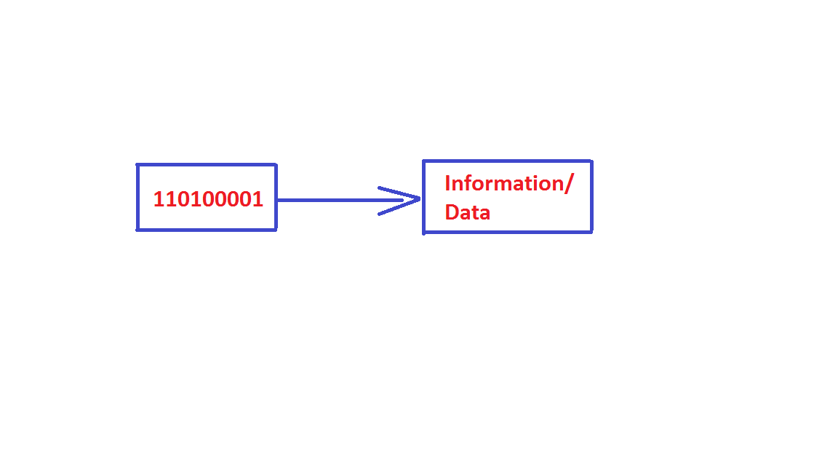
What is Deserialization?
Mechanism of reconstructing the object from the serialized state.

Slide 41
ObjectInputStream class
An ObjectInputStream deserializes objects and primitive data written using an ObjectOutputStream.
public ObjectInputStream(InputStream in) throws IOException {}

Slide 42
Conditions for serialization
              The class must implement the java.io.Serializable interface.This interface is the marker interface.
              It signifies that a class which implements Serializable interface can be serialized to file, database, memory or over network.
              All of the fields in the class must be serializable.
              If a field is not serializable it must be marked transient

Slide 43
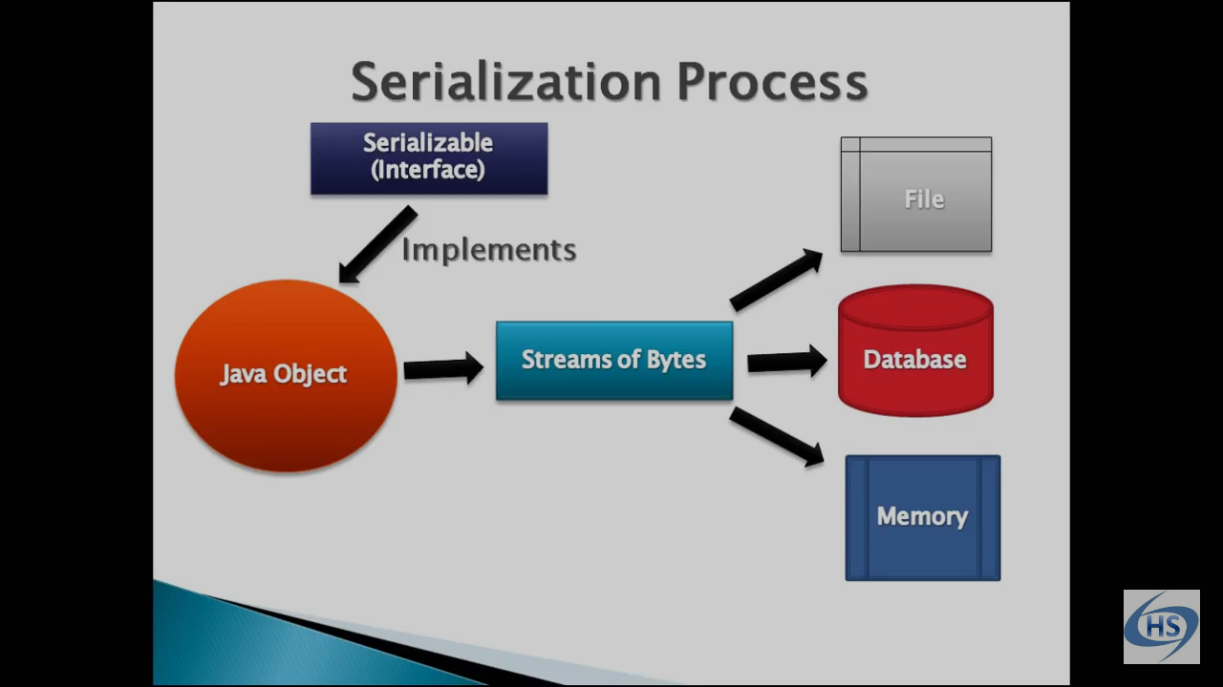

Slide 44
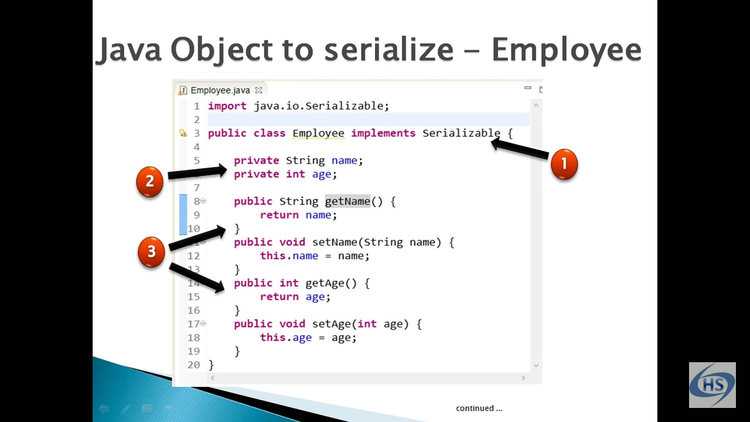

Slide 45
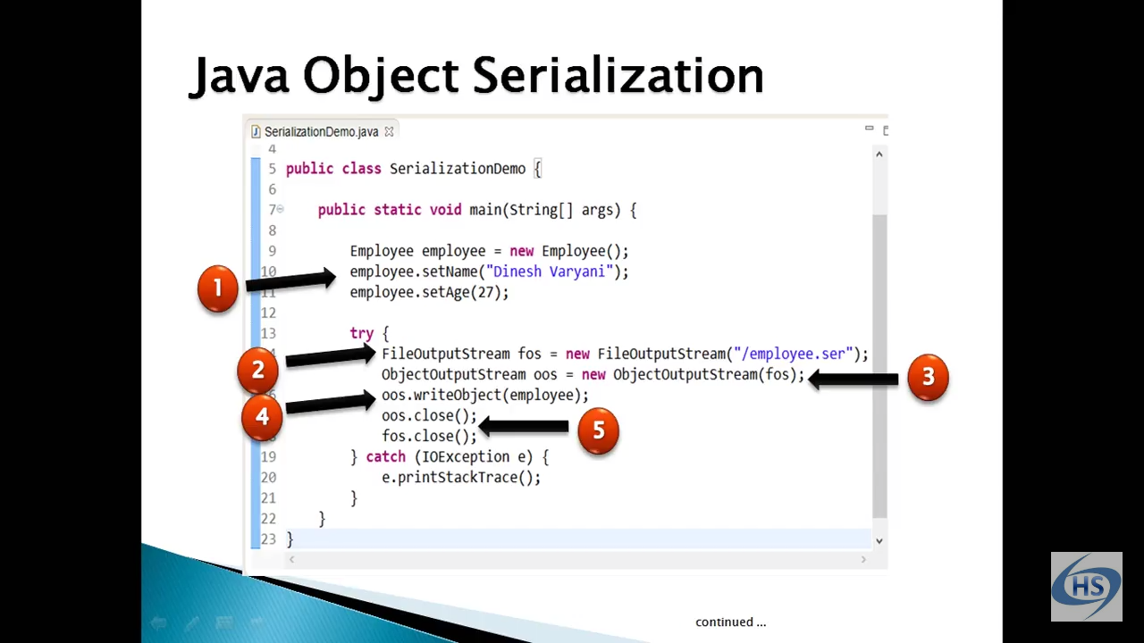

Slide 46
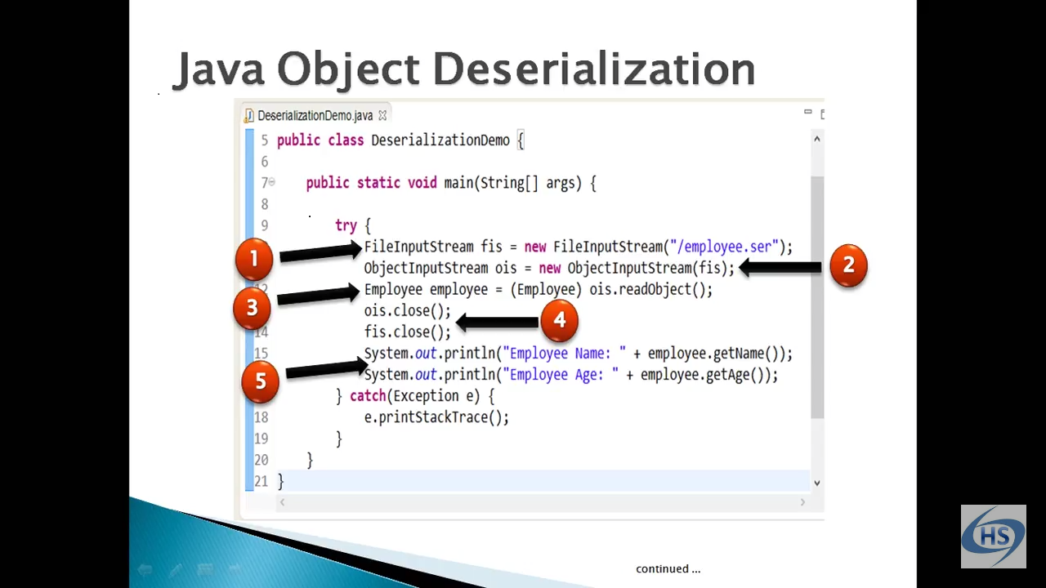

Slide 47
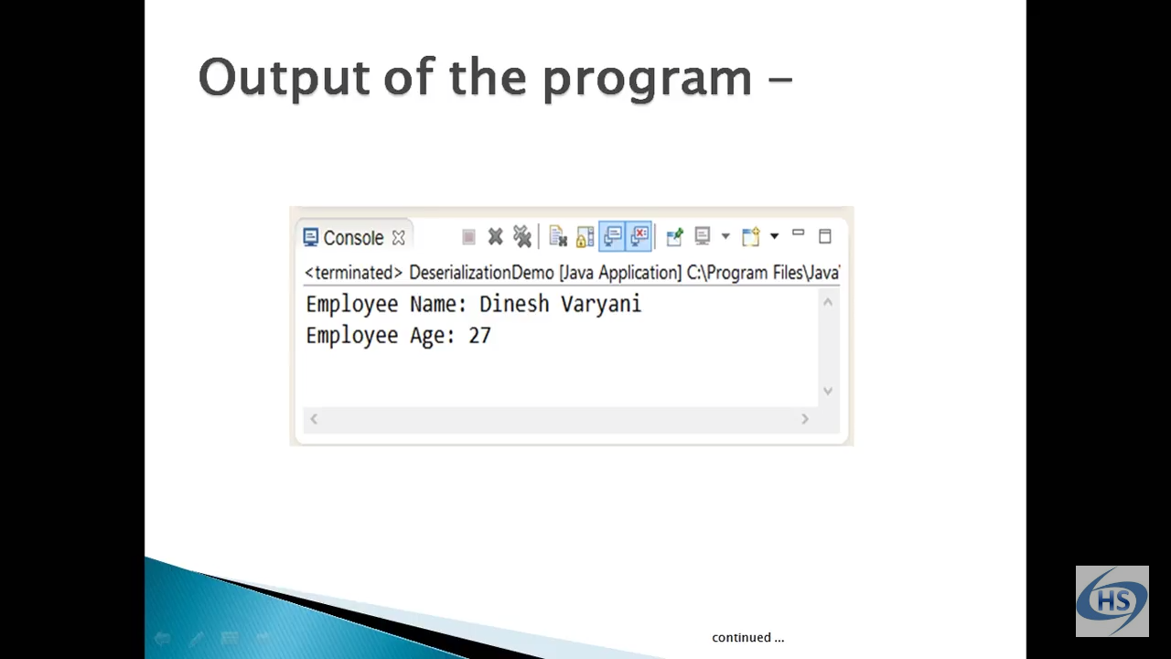

Slide 48
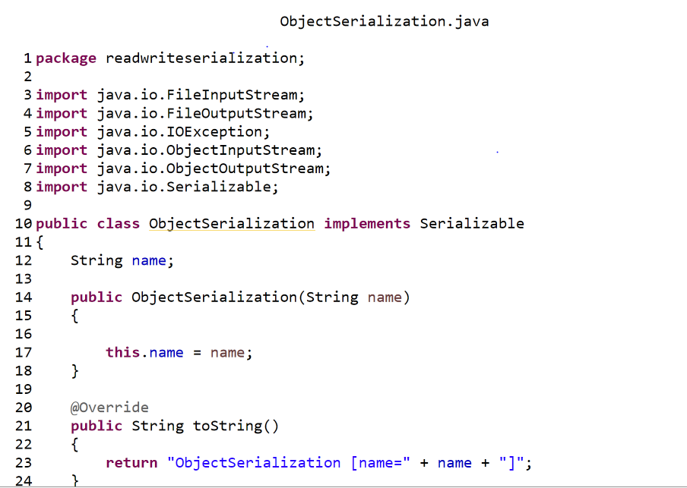

Slide 49
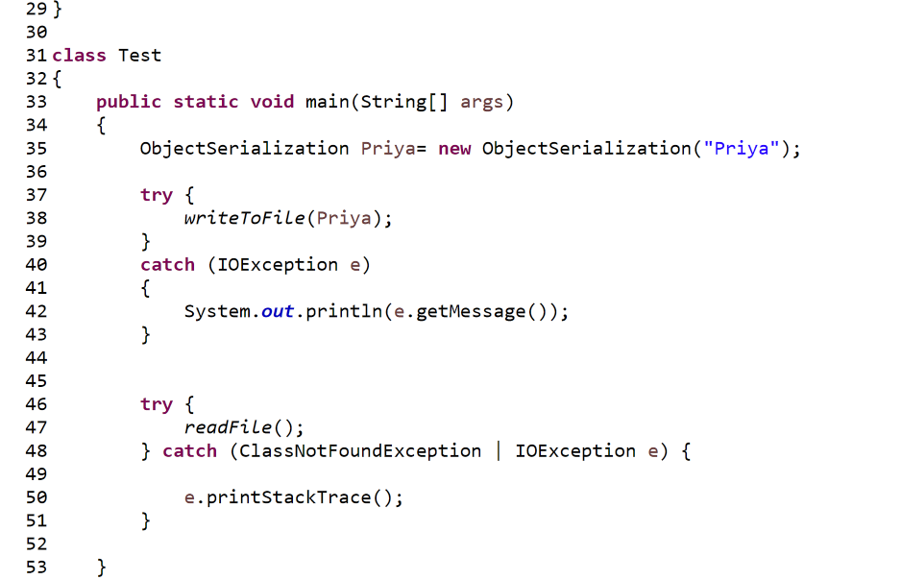

Slide 50
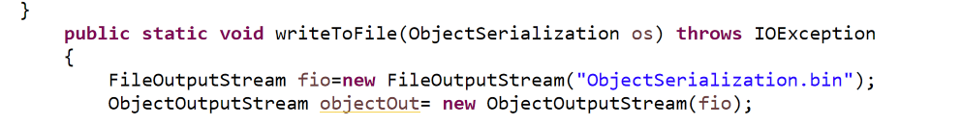
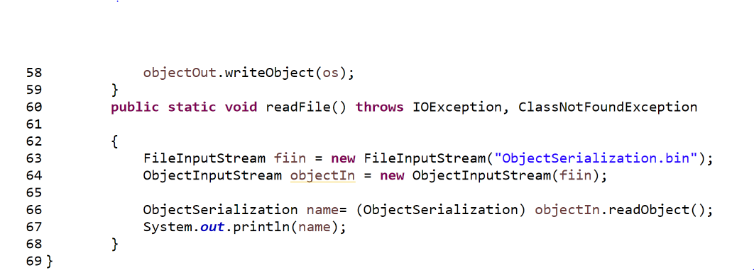

Slide 51
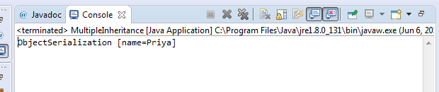
OUTPUT
ObjectSerialization [name=Priya]

Slide 52


